Slide 1

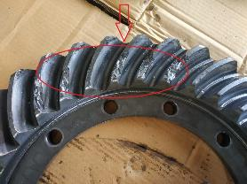
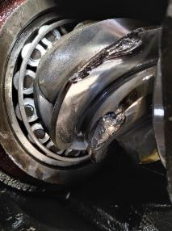
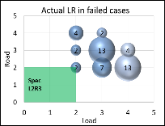
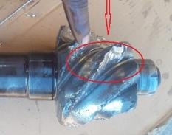
CWP failures in 1920 Tipper
Complaint / Problem details |  | CWP failures in Meritor MS149.7 & Dana 92S axle (1920 Tipper) |  |  |  | Issue status | RL5
 |  |  |  |  |  | Issue grade | V1
Model |  | 1920 Tipper (L2R3) | Failure Hrs | 15-3999 hours (85% > 500H) |  | DOF | Till Jan’23
Mfg plant |  | H2 & PNR | No of cases | 1256 |  | Resp | Appln / Sales
Observation/ Root cause | Observation / analysis: Majority of failure modes - Crown/ Pinion teeth chip off/ spalling in Meritor. Pinion teeth uprooting in Dana CWP material and hardness conforms to spec in both Meritor & Dana Majority of failures found in West Bengal, Jammu & Kashmir, Maharashtra, Tamil Nadu, HP, Assam (75% of failures) Majority of failures found in L3/L4 applications For L2R3, predicted B10 life 2625 hours (Meritor) & 3000 hours (Dana) No L3R3 spec available |  | Photos / Illustration |  | Illustration
 |  |  |  |  | v
Action | Separate CBN released for L3R3 spec with MS160 axle. C: Mar’22
Config | Load Road | GVW/ GCW Max (kgs) | Max. RAW/Axle (kgs) | RAR | Axle Model | Predicted Drive Head B10 life | Axle Hsg | Axle shaft
4X2 (Meritor) | L2R3 | 22,000 | 15,385 | 6.17 | MS1497 | 2,625 hr | X | R
4X2 (Dana) | L2R3 | 22,000 | 15,385 | 6.17 | D92S | 3,000 hr | R | P

Slide 2
Action
Before
After
Axle Model → | Dana 92S | MS149.7
Crown wheel Dia. | 441mm (17.36”) | 440.69mm (17.35”)
Face width | 69.70mm | 61.0mm
Oil capacity | 16 Ltrs | 16.0 – 17.0 Ltrs
Axle Model → | MS160
Crown wheel Dia. | 457.2mm (18”)
Face width | 69.85mm (2.75”)
Oil capacity | 19.0 to 20.0 Ltrs
Notes:
Content Slide

Slide 3
Failure trend
Note sent to field from service for sale of L4R3 Spec
Note sent to field from service for sale of L4R3 Spec
Separate CBN released for L3R3 spec with MS160 axle
Notes:
Content Slide

Slide 4
Data analysis - IPTV and WCPV
Data as on Sep’22
Calculation based on vehicles sold till --> | Jun-22 | Mar-22 | Dec-21 | Sep-21 | Jun-21 | Mar-21 | Dec-20 | Sep-20
MIS | 3 MIS | 6 MIS | 9 MIS | 12 MIS | 15 MIS | 18 MIS | 21 MIS | 24 MIS
Parc | 2,659 | 2,582 | 2,255 | 2,056 | 1,836 | 1,625 | 1,729 | 1,169
Incidence | 47 | 193 | 359 | 524 | 613 | 665 | 674 | 495
Over all cost | 18,04,703 | 72,31,180 | 1,31,74,554 | 1,92,97,328 | 2,20,73,905 | 2,35,91,892 | 2,42,67,561 | 1,75,95,420
% Failures | 1.77 | 7.47 | 15.92 | 25.49 | 33.39 | 40.92 | 38.98 | 42.34
WCPV | 679 | 2,801 | 5,842 | 9,386 | 12,023 | 14,518 | 14,036 | 15,052
Notes:
Content Slide

Slide 5
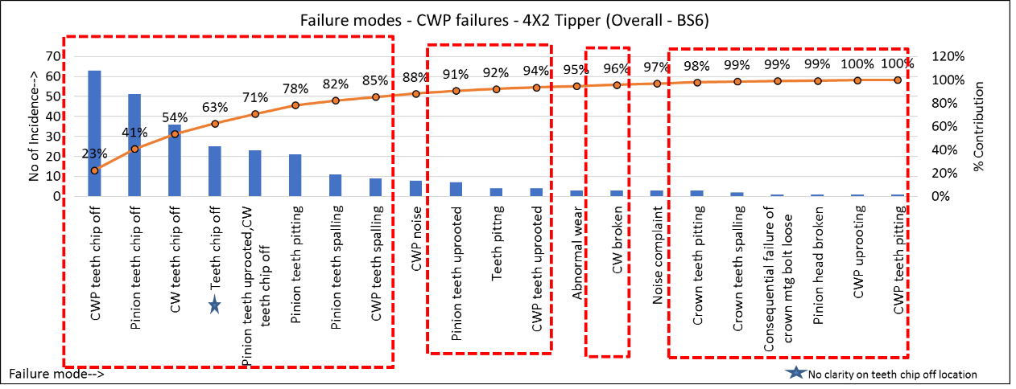
Data analysis: BS6 - CWP failures in 4x2 Tipper (L2R3)
Data as on Oct’21
Total no. of failures booked in Crown wheel pinion complaint code – 280 nos.
CWP Teeth chip off, spalling, uprooting, pitting, CW broken & pinion head breakage contributes to 95%
Notes:
Content Slide

Slide 6
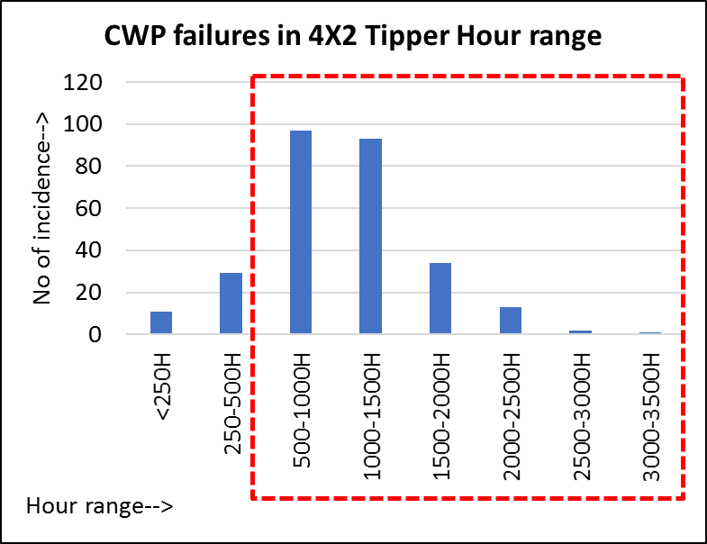
Data analysis: BS6 - CWP failures in 4x2 Tipper (L2R3)
Data as on Oct’21
Failure mode | <250H | 250-500H | 500-1000H | 1000-1500H | 1500-2000H | 2000-2500H | 2500-3000H | 3000-3500H | Grand Total
CWP teeth chip off | 1 | 10 | 24 | 19 | 4 | 5 |  |  | 63
Pinion teeth chip off | 3 | 2 | 22 | 18 | 4 | 1 | 1 |  | 51
CW teeth chip off | 1 | 2 | 13 | 14 | 6 |  |  |  | 36
Teeth chip off | 2 | 1 | 8 | 7 | 4 | 3 |  |  | 25
Pinion teeth uprooted,CW teeth chip off |  | 3 | 9 | 5 | 6 |  |  |  | 23
Pinion teeth pitting | 1 | 4 | 5 | 5 | 4 | 2 |  |  | 21
Pinion teeth spalling |  | 1 | 2 | 5 | 2 | 1 |  |  | 11
CWP teeth spalling |  | 2 | 1 | 5 | 1 |  |  |  | 9
CWP noise | 1 |  | 1 | 5 |  |  |  | 1 | 8
Pinion teeth uprooted |  |  | 4 | 2 |  |  | 1 |  | 7
Teeth pitting |  |  | 1 | 2 | 1 |  |  |  | 4
CWP teeth uprooted |  |  | 2 | 1 | 1 |  |  |  | 4
Abnormal wear | 1 | 2 |  |  |  |  |  |  | 3
CW broken | 1 | 1 | 1 |  |  |  |  |  | 3
Noise complaint |  | 1 | 1 | 1 |  |  |  |  | 3
Crown teeth pitting |  |  |  | 2 | 1 |  |  |  | 3
Crown teeth spalling |  |  | 2 |  |  |  |  |  | 2
Consequential failure of crown mtg bolt loose |  |  |  | 1 |  |  |  |  | 1
Pinion head broken |  |  |  | 1 |  |  |  |  | 1
CWP uprooting |  |  |  |  |  | 1 |  |  | 1
CWP teeth pitting |  |  | 1 |  |  |  |  |  | 1
Grand Total | 11 | 29 | 97 | 93 | 34 | 13 | 2 | 1 | 280
86% of total Crown wheel pinion failures occurred beyond 500 hours of operation which implies failures are not premature
Notes:
Content Slide

Slide 7
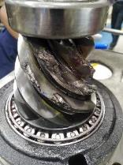
Tear down analysis - MB1G8DHD6LRCF0923
1 tooth uprooted in pinion, 1 tooth chipped off at heel end, 1 tooth chipped off at toe end and in 1 tooth surface crack observed. Consequential teeth chip off found in few crown teeth
CWP backlash found 0.4, 0.5, 0.45 , 0.45 mm as against the spec of 0.2-0.46 mm
Crown face out found 0.2 mm as against the spec of 0.25 mm max
Crown runout found 0.14 mm
No end play found in companion flange
Pinion TTR at drive head level found 2 Nm
Pinion end nut torque identification line mark found intact Cotter pin condition found intact
Adjuster ring found tight
Bearing cap bolt torque found 820, 900, 890, 840 Nm (Spec: 600±10Nm + 50°±2°. Resultant torque: 850-1070Nm)
Differential bearing preload: Torque released from bearing cap bolts. Dial kept in flange half side bearing cap lug. Then the plain half side adjuster ring tightened. Deflection starts immediately when adjuster ring rotated which implies existence of preload.
No diff bearing rotation marks observed
No gap found between diff bearing face & diff case face (Flange half & plain half side) – Checked with 0.050 mm shim
Pilot bearing: Inner race found intact with pinion. (Make: nbc. 1405119 N1242)
No gap found between crown & flange half face. Checked with 0.050 mm shim
No abnormalities observed
Notes:
Content Slide

Slide 8
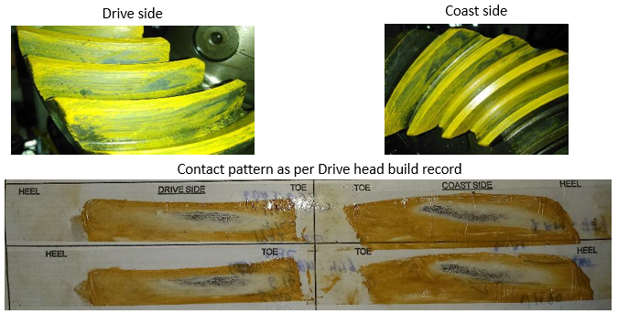
Tear down analysis - MB1G8DHD6LRCF0923
No abnormalities observed
Roll testing: Contact pattern found as shown below (hand rolled). Since pinion teeth chipped off not able to capture contact pattern properly
Parameter | Observation | Parameter | Observation
Pinion cage mounting face to inner bearing face | 40.248 / 40.238 mm | D dimension in carrier – Pinion cage mtg face to Crown axis (Identification in carrier: 51) | 268.51 mm
Pinion face to crown axis for 0 Pinion PMD | 229 mm
Pinion PMD (+15 thou) | 0.381 mm
Pinion mounting distance | 269.629/ 269.619 mm
Difference between Pinion mtg distance & D dimn in carrier: 1.12/ 1.11 mm – No abnormality found wrt actual shim thickness available
Notes:
Content Slide

Slide 9
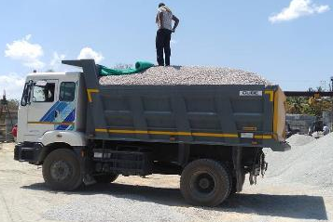
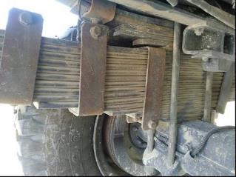
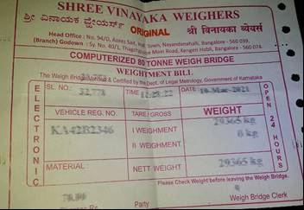
Field JI - MB1G8DHD6LRYG8627
Reg No : KA42 B2346
Chassis No : MB1G8DHD6LRYG8627
Model : 1920 Tipper
DOS : 27-Nov-20
DOF : 11-Feb-21
Hrs. Covered : 271Hrs
KM Covered : 8,240km
Application : Blue metal
Actual GVW : 29.3T
Operating route : Bidadi to Kumbalgodu
Lead distance : 46 km – Kuchha raod – 2 km, Single road – 16 km, Highway – 28 km. Gradient involved on the route – 4 km
Based on the field joint study, the actual LR category found L4R2 against the spec
Notes:
Content Slide

Slide 10
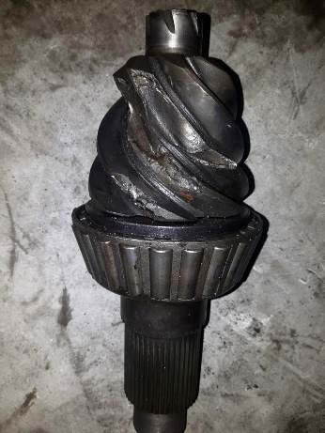
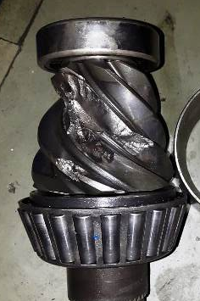
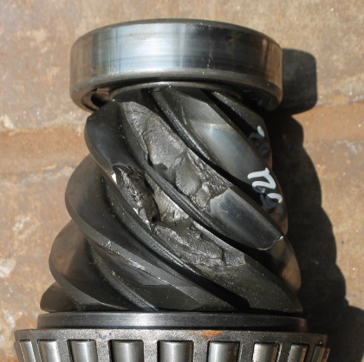
Failure mode
Primary failure mode in all the cases found to be pinion teeth uprooting which indicates shock load failure
Notes:
Content Slide

Slide 11
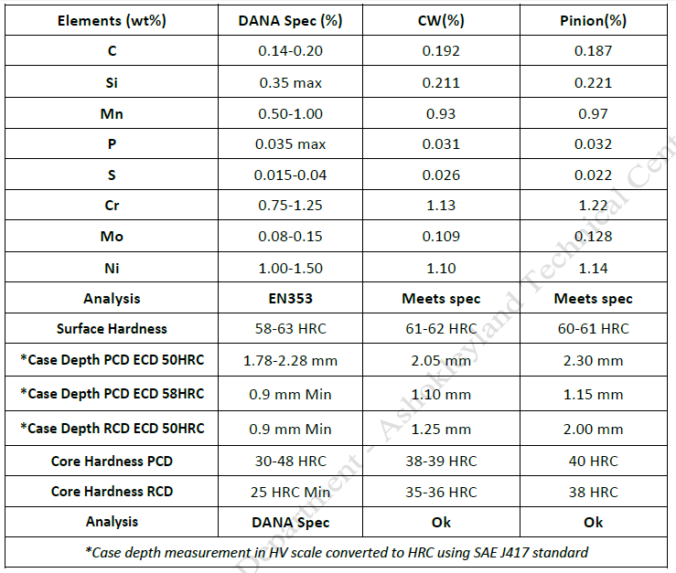
CWP failures in Dana 92S (1920 Tipper) Material analysis
Material conforms to spec
Notes:
Content Slide

Slide 12
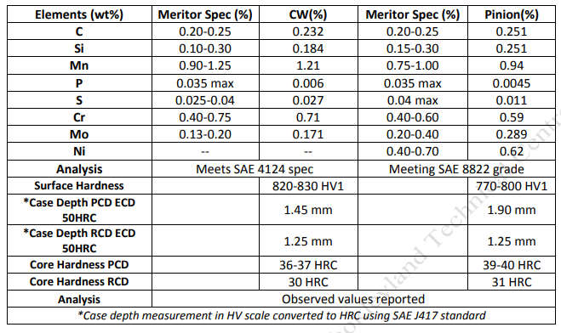
CWP failures in Meritor MS149.7 (1920 Tipper) Material analysis
Material conforms to spec
Notes:
Content Slide

Slide 13
Summary
Failed CWP material & hardness conforms to spec
Based on tear down analysis of failure reported drive head, no abnormalities found in drive head assembly
Field study at Bangalore reveals, vehicle operated under L4R2 category against the spec of L2R3
Majority of failures are reported in L3 & L4 application against spec of L2
Based on the failed part analysis & field study, the failure is attributed to overload application against specified LR
The spec upgradation of axle w.r.t higher LR & hilly spec is recommended
Notes:
Content Slide

Slide 14
B10 life prediction by Meritor & Dana
Meritor
Config | Load Road | GVW/ GCW Max (kgs) | Max. RAW/Axle (kgs) | RAR | Axle Model | Predicted Drive Head B10 life | Axle Hsg | Axle shaft
4X2 | L2R3 | 22,000 | 15,385 | 6.17 | MS1497 | 2,625 hr | X | R
4X2 | L4R3 | 33,000 | 24,231 | 6.17 | MS160 | 1,525 hr | X | X
4X2 | L4R1 | 33,000 | 24,231 | 6.17 | MS1497 | 7,025 hr | X | X
Dana
Config | Load Road | GVW/ GCW Max (kgs) | Max. RAW/Axle (kgs) | RAR | Axle Model | Predicted Drive Head B10 life | Axle Hsg | Axle shaft
4X2 | L2R3 | 22,000 | 15,385 | 6.17 | D92S | 3,000 hr | R | P
4X2 | L4R1 | 33,000 | 24,231 | 6.17 | D92S | 2,000 hr | X | P
Notes:
Content Slide

Slide 15
PD Proposal / Action
Config | Load Road | GVW | RAW | RAR | Curr. / Prop. | Meritor
 |  |  |  |  |  | Axle Model | Cost Δ | Drive Head B10 life | Axle Hsg | Axle shaft
4X2 | L2R3 | 22,000 | 15,385 | 6.17 | Curr. | MS1497 | <REF> | 2,625 hr | X | R
" | " | " | " | " | Prop. | <MR160 18TG> | 38,000 | >6,000 hr approx. | P | P
Separate CBN for L3R3 is released with MS160 axle / HDS with RAR 5.83
Notes:
Content Slide

Slide 16

Notes:
End slide

